Slide 1
Databricks, Spark, Machine Learning and Azure Synapse Analytics
AN END-TO-END EXAMPLE OF DATA IN THE CLOUD
We’re Hiring a Big Data Engineer!
Talk to me about the opportunities
Simon Kingaby
Manager, Global Data and Analytics
Deloitte Touche Tohmatsu Limited | Global Shared Services
skingaby@deloitte.com
Blog: omwtm.blog
linkedin.com/in/skingaby/

Slide 2


Agenda
Tools
Setup
1: Getting Some Data to Analyze
2: Loading the Data Lake
3: Processing the data in Databricks
4: Creating the Machine Learning Model
5: Detour! Create a Custom Docker Base Image
6: Configure the Model for Deployment
7: Build and Deploy the Docker image
8: Testing the Webservice
9: Loading the Data Warehouse
10: Creating a Power BI Report
Breathe

Slide 3

Tools
Data Studio
Storage Explorer
Resource Group
Data Factory
Blob Storage
Data Lake
Key Vault
Application Insights
SQL Server
Databricks
Container Registry
Machine Learning
Synapse Analytics (SQL DW)
Power BI

Slide 4

What is the Question?
We’re looking at 2009 to 2015 Crime Data from the FBI’s Uniform Crime Reporting Program
What we want to know:
Given the limited information we have about the victim, can we use Machine Learning to predict who the offender was?
In other words:
Whodunnit?

Slide 5
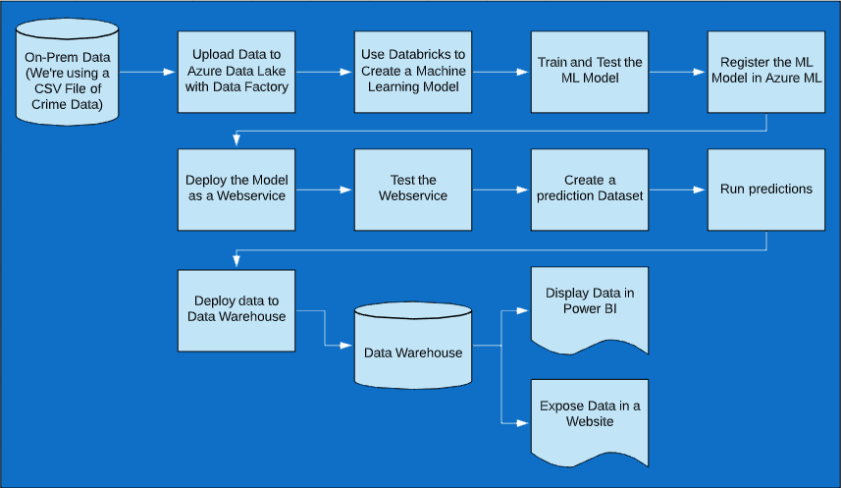

Process Flow Chart

Slide 6
Why Bother?
To solve the question of Whodunnit? We need to use Machine Learning
To solve it in Azure, we need to set up an ML Model
To do that, you can use the Azure ML tools, or Databricks and Python (we’ll be doing the latter as this seems more “automatable”)
To expose your Azure ML to Power BI and the Web you need to deploy it as a Webservice (and there are some issues with doing that currently, which we will cover in this session)

