Slide 1
Using Biml to Automate the Generation of SSIS Packages
Simon Kingaby
skingaby@bmi.com

Slide 2
Session Abstract
So you need to move data from 75 tables on the mainframe to new tables in SQL Azure. Do you: a) hand code one package to load all 75 tables, b) hand code 75 packages that move a table each, or c) wish there was a better way?
There is! Business Intelligence Markup Language (Biml) can automate the creation of packages so that they all follow the same script.
In this beginner level session, we will create some simple metadata to be able to generate multiple packages and their associated connection managers. You will see Biml in action. You will see the XML that Biml uses to define packages and connections. You will see the C# code that Biml uses to fetch metadata and dynamically generate packages in SSIS. And you will see packages and connection managers generated from Biml before your very eyes.

Slide 3
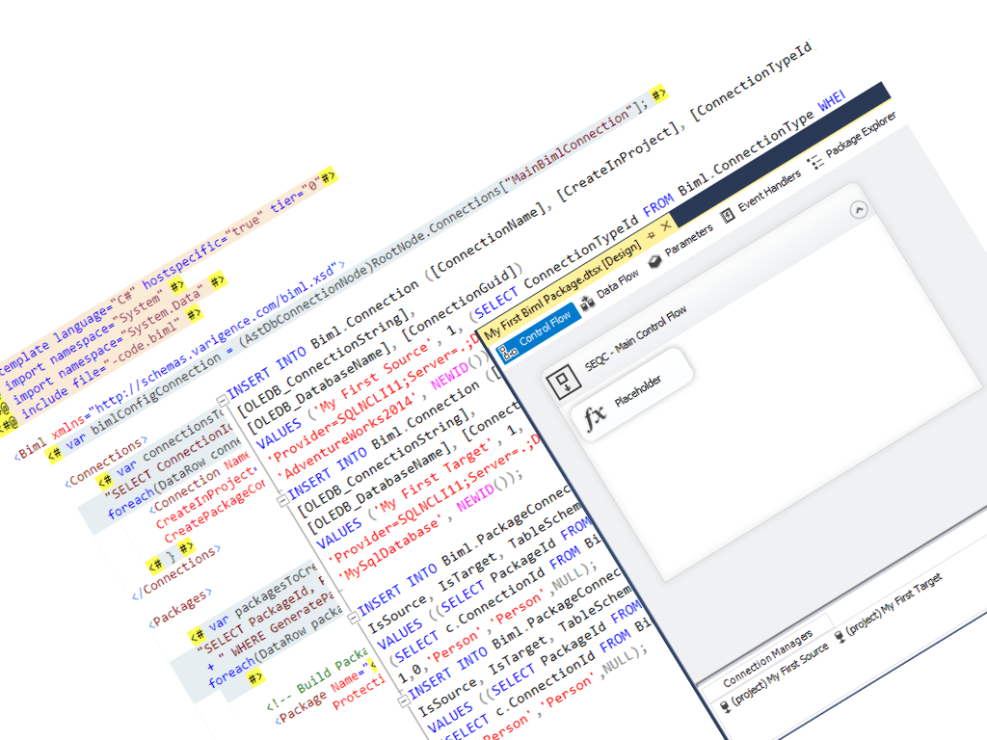
What you will see in the next hour
Actual Biml Code
Actual Metadata
Actual SSIS Package Generation

Slide 4
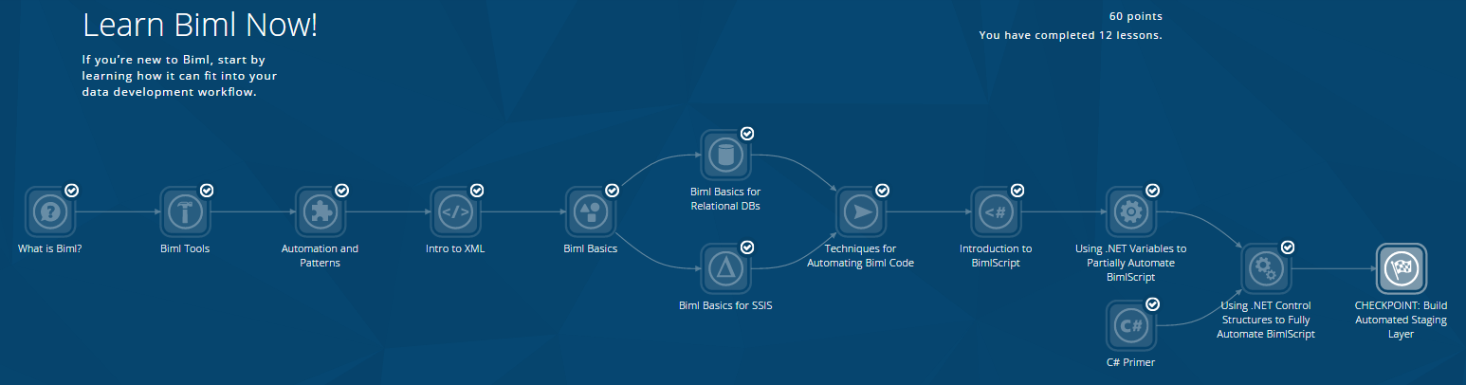
What is Biml?
Only the most amazing development in SSIS package generation ever
Business intelligence markup language (Biml) is a programming language for creating and automating data solutions
Biml uses XML and small nuggets of C# or VB code to automatically create huge amounts of SQL scripts, SSIS packages, and SSAS cubes.

Slide 5
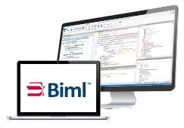

How do I get this incredible tool?
For SQL Server 2012 and earlier, get the relevant BIDS Helper version from https://bidshelper.codeplex.com/
For SQL server 2014 and later, use VS 2015 and get the Biml Express plug-in from varigence.com/bimlexpress
Use BimlOnline
Get Mist/BimlStudio from varigence.com

Slide 6
Demo!
My first Biml script
Some metadata tables
Some C# code
My second Biml script
Package generation
My third Biml script

